Slide 1


ENGLISH LEVEL B1 - II
Lesson 06
RENTING A FLAT - DESCRIBING WHAT YOU ARE LOOKING FOR

Slide 2

01
Talk about renting a flat
02
How to describe what you are looking for
03
Practice speaking with a partner
ENGLISH LEVEL B1 - II
Notes:
Teacher notes: Introduce key vocabulary related to the environment and encourage students to discuss its importance.
Have them practice speaking in groups and share their ideas on protecting nature.

Slide 3
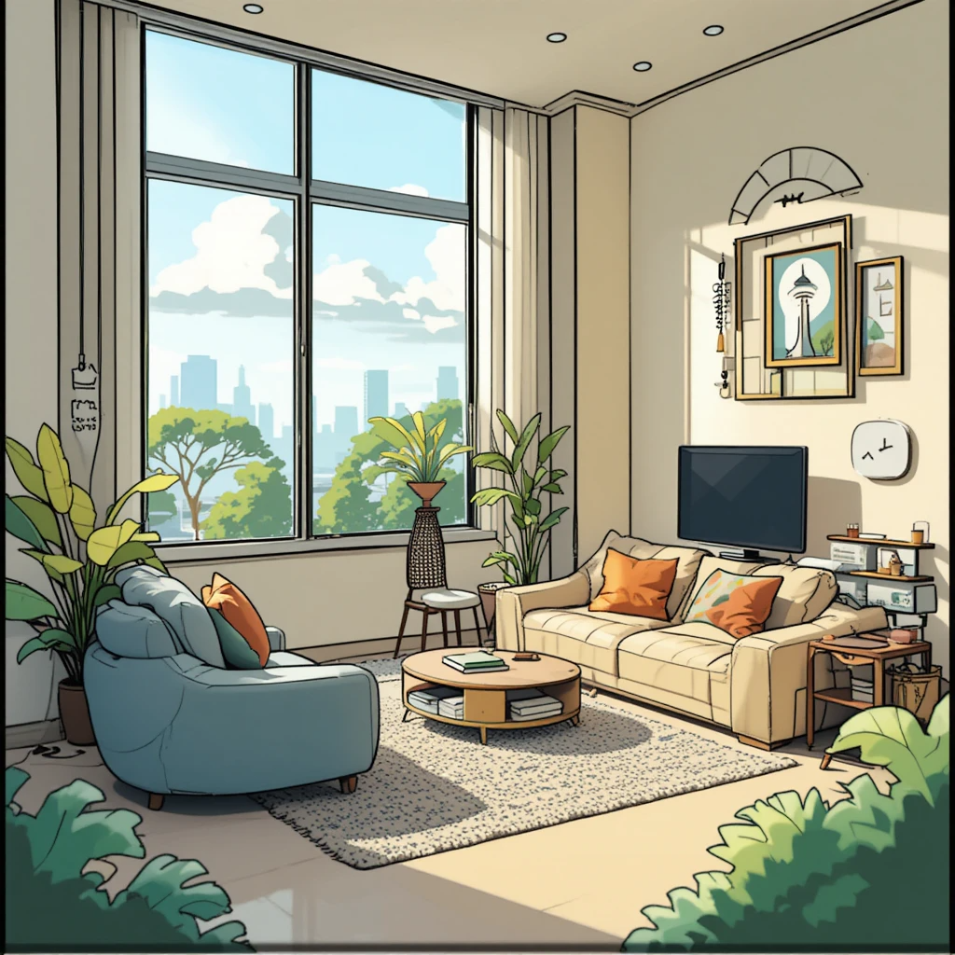
RENTING A FLAT - DESCRIBING WHAT YOU ARE LOOKING FOR
RENTING A FLAT
Look at the picture and answer the questions.
Questions:
1
Is this flat big or small?
2
Do you like this flat?
2
Why or why not?
Notes:
Teacher Notes:
Show students pictures of different flats.
Ask them to describe what they see using simple words.
Encourage students to use short sentences. Example: "It is a big flat in the city."

Slide 4
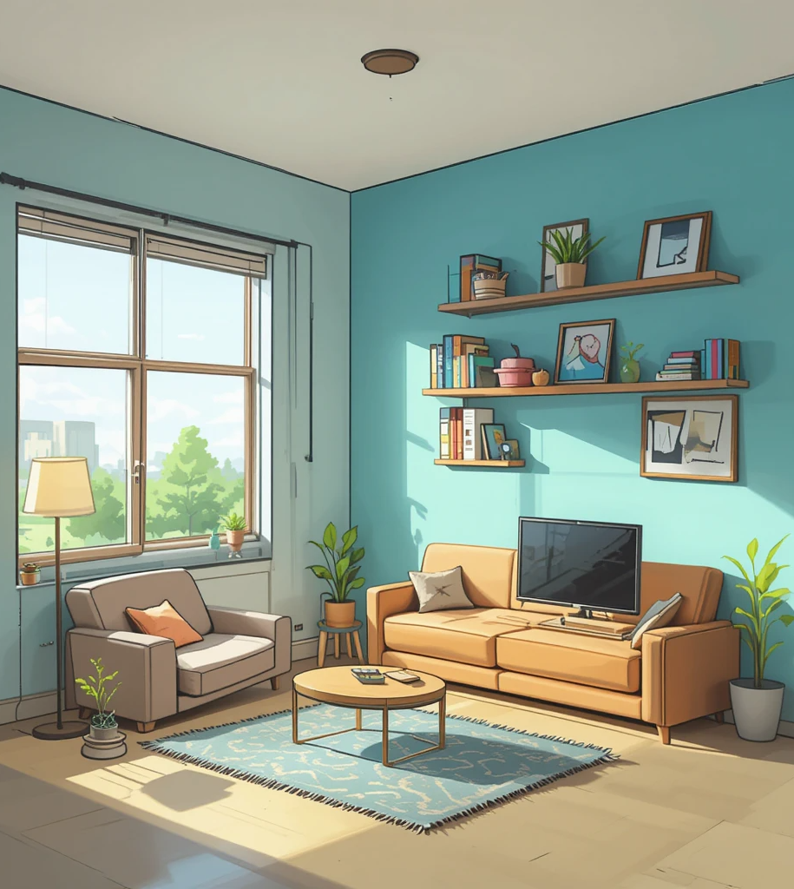
RENTING A FLAT - DESCRIBING WHAT YOU ARE LOOKING FOR
Vocabulary:
Flat / Apartment (a place to live)
Rent (money you pay every month)
Lease (contract to rent a flat)
Landlord (person who owns the flat)
Cheap / Expensive (low or high price)
Bright / Dark (light in the room)
Notes:
Teacher Notes:
Read words aloud, and students repeat.
Ask: "Is it better to have a bright or dark flat?"

Slide 5
RENTING A FLAT - DESCRIBING WHAT YOU ARE LOOKING FOR
Practice the vocabulary!
Complete with the correct words:
I want to ______ a new flat in the city.
My ______ is very kind. He always helps me with repairs.
The rent is ______, so I can afford this apartment.
I need to sign the ______ before I move in.
This flat is in the ______, not in the city center.
We will ______ next week, so we are packing our things.
I saw an ______ for a cheap flat in the newspaper.
Notes:
Teacher notes:
Students complete the sentences using the correct vocabulary related to renting a flat.
Encourage them to discuss their answers and use the words in their own sentences.

Slide 6

RENTING A FLAT - DESCRIBING WHAT YOU ARE LOOKING FOR
Practice with a Partner
Work in pairs: One student is looking for a flat, and the other is the landlord.
Use these questions:
Example Conversation
Landlord: Hello! Are you looking for a flat? Tenant: Yes, I am.
Landlord: What kind of flat do you want? Tenant: I want a small flat with one bedroom and a kitchen.
Landlord: Where do you want to live? Tenant: I want to live near the city center.
Landlord: How much can you pay? Tenant: I can pay $600 per month.
1
What kind of flat do you want?
2
Where do you want to live?
3
How much can you pay?
Notes:
Teacher Notes:
Encourage full sentences: "I want a flat in the suburbs. I can pay $800 per month."
Have students switch roles.

Slide 7
RENTING A FLAT - DESCRIBING WHAT YOU ARE LOOKING FOR
Put the Words in Order
flat / looking / I / for / am / a / big.→_______________________
in / city / lives / my / the / friend. →________________________
is / expensive / very / this / rent. →________________________
landlord / kind / my / very / is. →__________________________
wants / a / she / cheap / flat. →___________________________
a / bright / I / room / want. →____________________________
Notes:
Teacher Notes:
Give students two minutes to try arranging the words in the correct order.
Have students compare their answers with a partner before checking as a class.
Write the correct sentences on the board and discuss any mistakes.

Slide 8
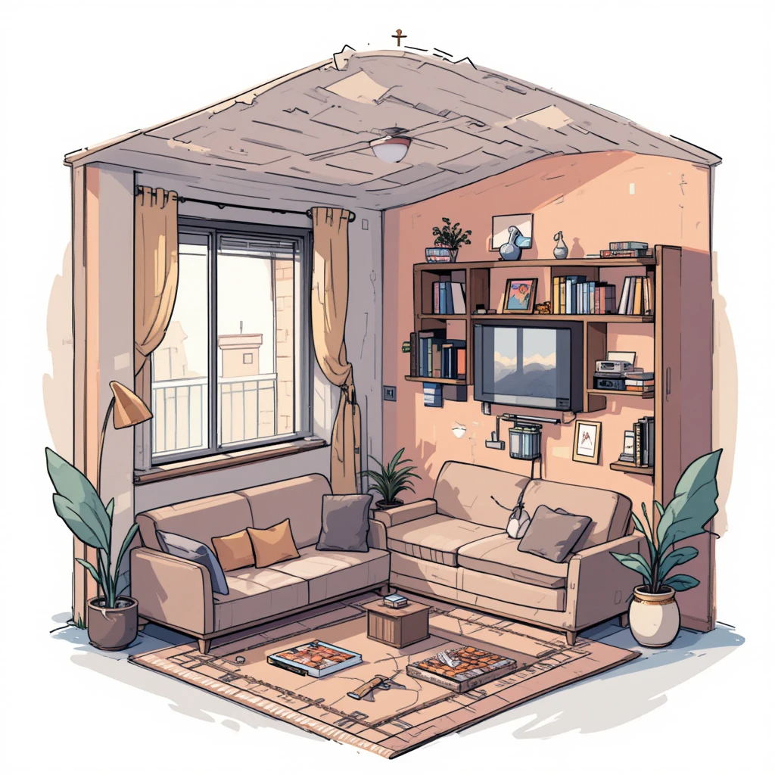
RENTING A FLAT - DESCRIBING WHAT YOU ARE LOOKING FOR
GROUP DISCUSSION
Work in small groups. Describe your perfect flat:
1
How many rooms?
2
Where is it?
3
How much is the rent?
Notes:
Teacher notes: Students work in small groups to describe their ideal flat using the guiding questions.
Encourage them to use full sentences and share their ideas with the class.

Slide 9
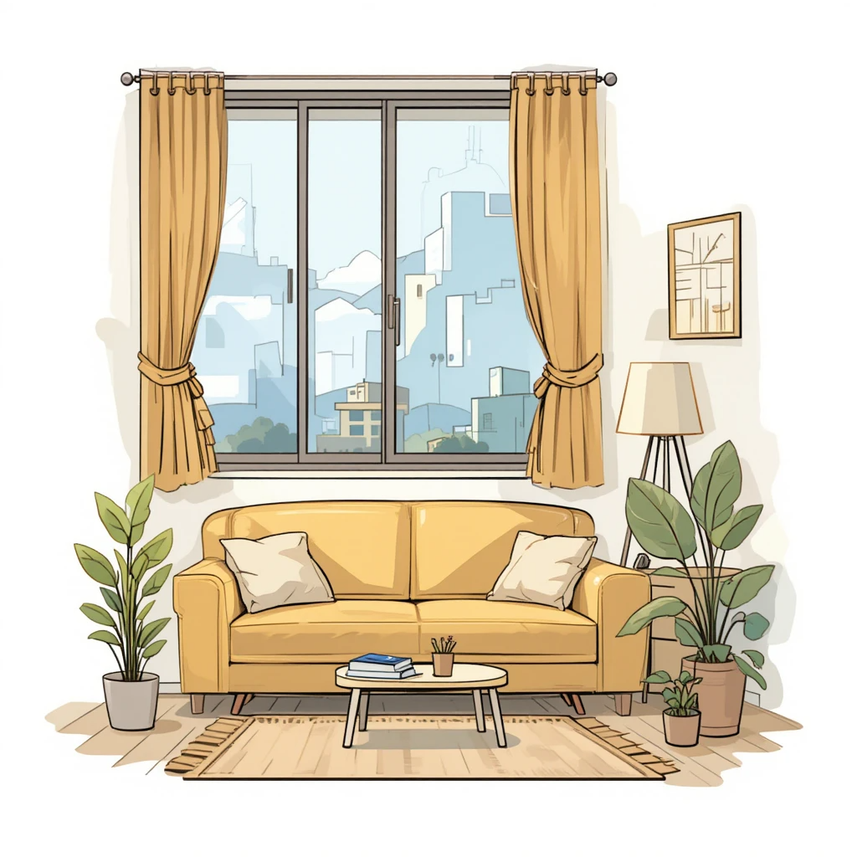

RENTING A FLAT - DESCRIBING WHAT YOU ARE LOOKING FOR
CHECK YOUR LEARNING
Write three sentences to describe the flat you are looking for and share them in the class chat.
Example:
I want a flat in the city.
It must have a balcony.
The rent should be affordable.
Notes:
Teacher Notes:
Share your answers with the class.
Compare and discuss different preferences.

